Slide 1
Numerical Methods
Number Representation and Accuracy

Slide 2
Number Representation and Accuracy
Number Representation
Normalized Floating Point Representation
Significant Digits
Accuracy and Precision
Rounding and Chopping

Slide 3
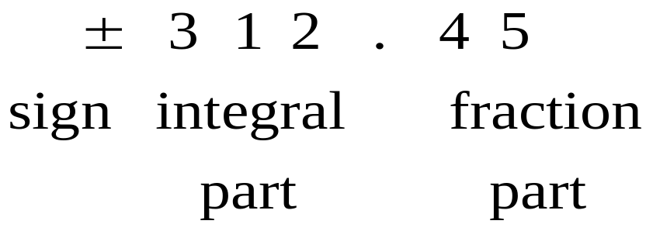
Representing Real Numbers
You are familiar with the decimal system:
Decimal System: Base = 10 , Digits (0,1,…,9)
Standard Representations:

Slide 4
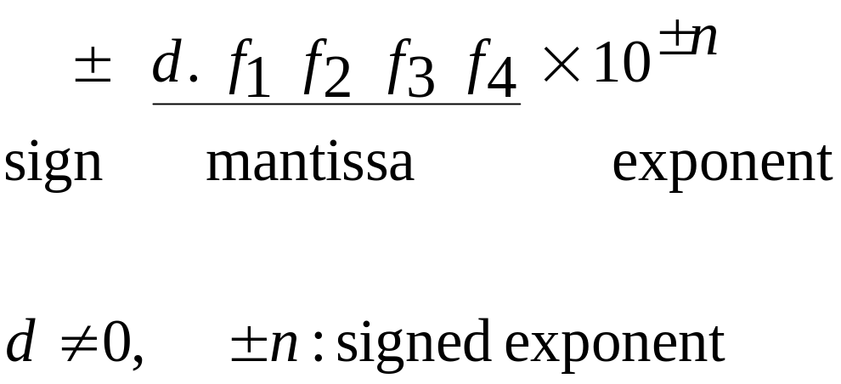
Normalized Floating Point Representation
Normalized Floating Point Representation:
Scientific Notation: Exactly one non-zero digit appears before decimal point.
Advantage: Efficient in representing very small or very large numbers.

Slide 5
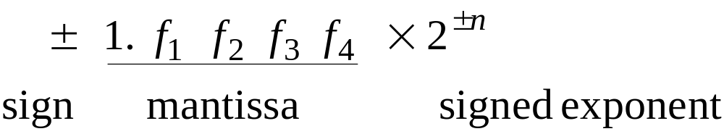
Binary System
Binary System: Base = 2, Digits {0,1}

Slide 6
Fact
Numbers that have a finite expansion in one numbering system may have an infinite expansion in another numbering system:
You can never represent 1.1 exactly in binary system.

Slide 7
IEEE 754 Floating-Point Standard
Single Precision (32-bit representation)
  1-bit Sign + 8-bit Exponent + 23-bit Fraction
Double Precision (64-bit representation)
  1-bit Sign + 11-bit Exponent + 52-bit Fraction
S
Exponent⁸
Fraction²³
S
Exponent¹¹
Fraction⁵²
(continued)

Slide 8
Significant Digits
Significant digits are those digits that can be used with confidence.
Single-Precision: 7 Significant Digits
  1.175494… × 10⁻³⁸ to 3.402823… × 10³⁸
Double-Precision: 15 Significant Digits
  2.2250738… × 10⁻³⁰⁸ to 1.7976931… × 10³⁰⁸

Slide 9
Remarks
Numbers that can be exactly represented are called machine numbers.
Difference between machine numbers is not uniform
Sum of machine numbers is not necessarily a machine number

Slide 10
Calculator Example
Suppose you want to compute:
3.578 * 2.139
using a calculator with two-digit fractions
3.57
*
2.13
=
7.60
True answer:
7.653342

Slide 11
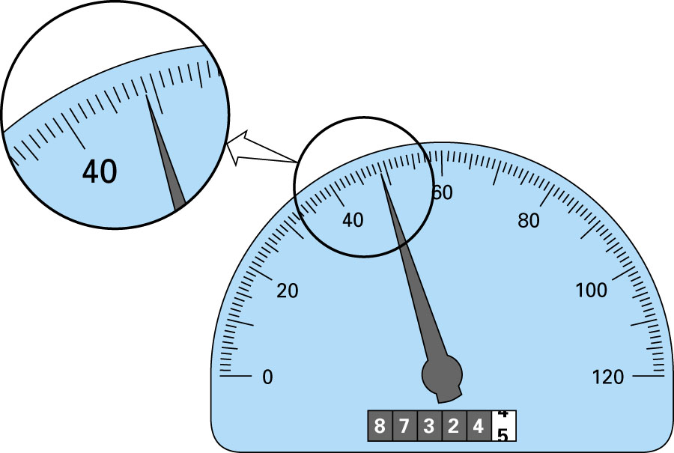
48.9
Significant Digits - Example

Slide 12
Accuracy and Precision
Accuracy is related to the closeness to the true value.
Precision is related to the closeness to other estimated values.

Slide 13
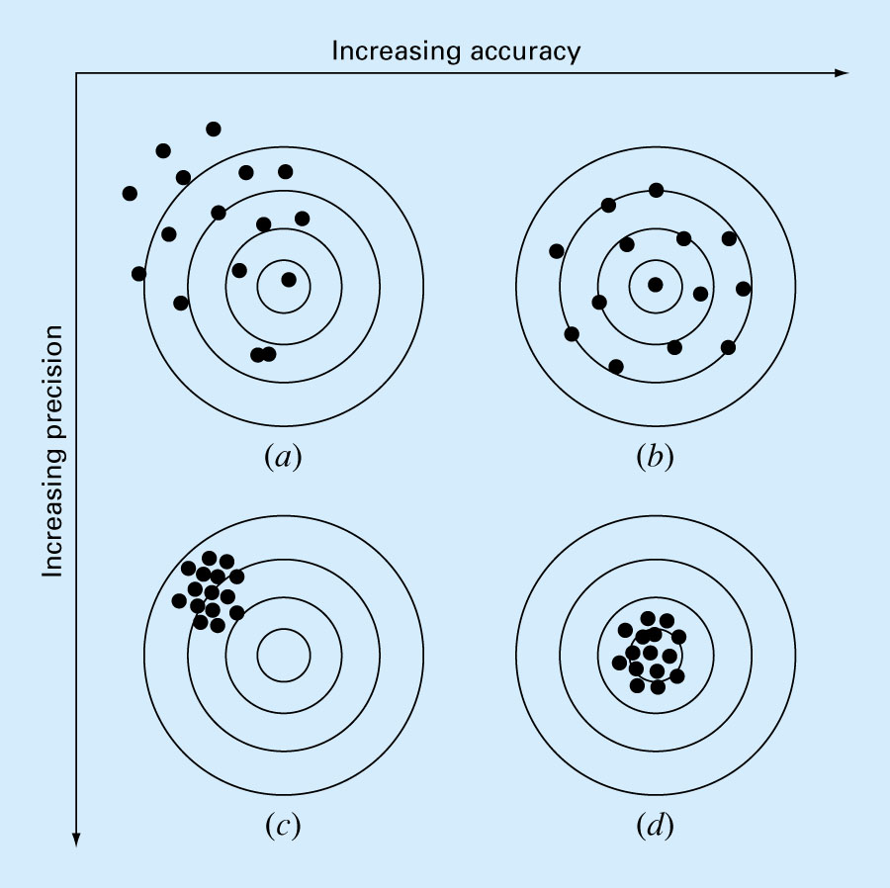

Slide 14
Rounding and Chopping
Rounding: Replace the number by the nearest
machine number.
Chopping: Throw all extra digits.

Slide 15
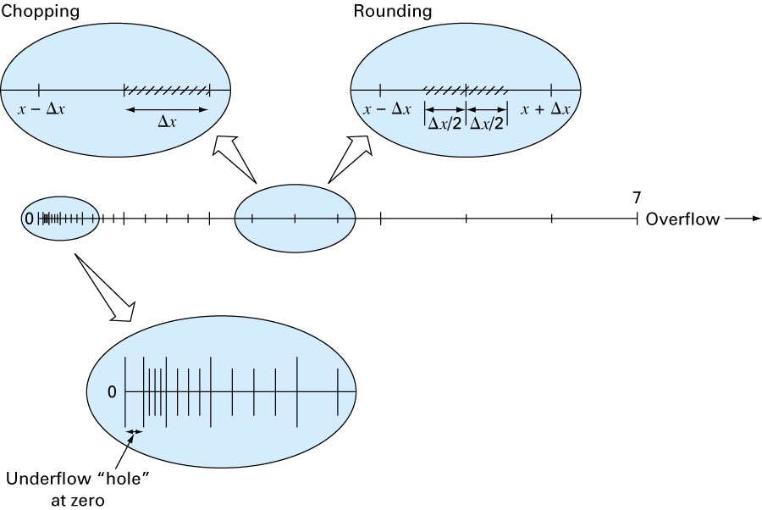
Rounding and Chopping

Slide 16
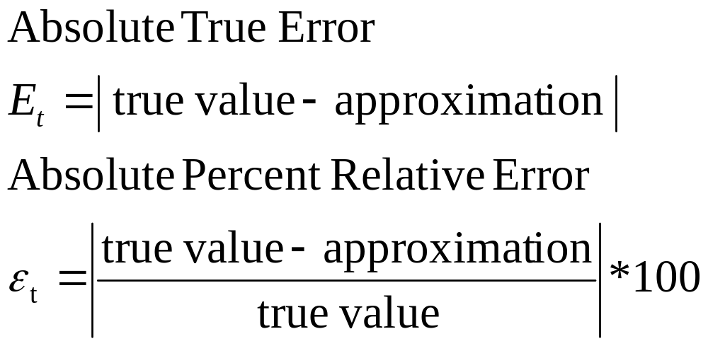
Error Definitions – True Error
Can be computed if the true value is known:

Slide 17
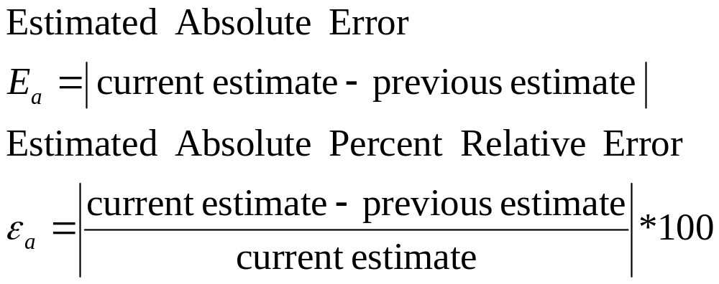
Error Definitions – Estimated Error
When the true value is not known:

Slide 18
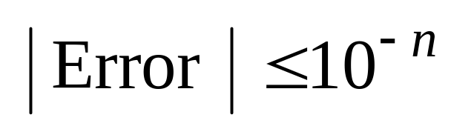
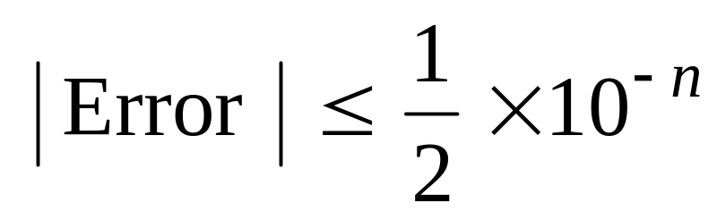
Notation
We say that the estimate is correct to n decimal digits if:
We say that the estimate is correct to n decimal digits rounded if:

Slide 19
Summary
Number Representation
Numbers that have a finite expansion in one numbering system may have an infinite expansion in another numbering system.
Normalized Floating Point Representation
  Efficient in representing very small or very large numbers,
  Difference between machine numbers is not uniform,
  Representation error depends on the number of bits used in the mantissa.

Slide 20
Taylor Theorem
Motivation
Taylor Theorem
Examples

Slide 21
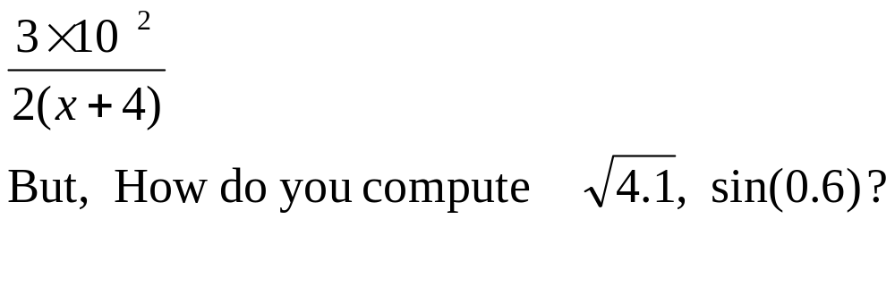
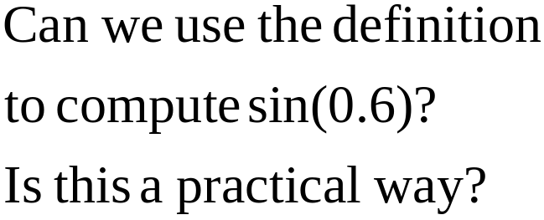
Motivation
We can easily compute expressions like:
b
a
0.6

Slide 22
Remark
In this course, all angles are assumed to be in radian unless you are told otherwise.

Slide 23
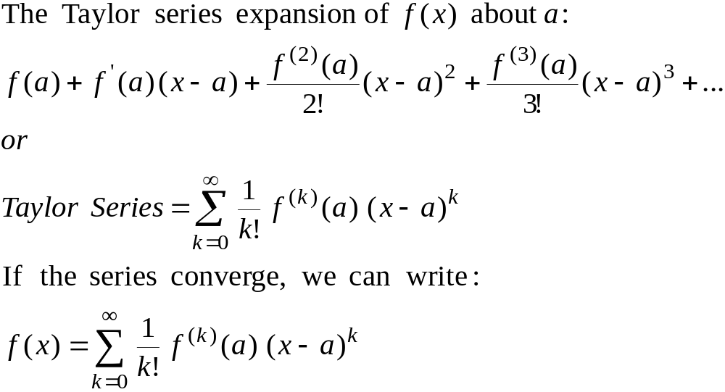
Taylor Series

Slide 24
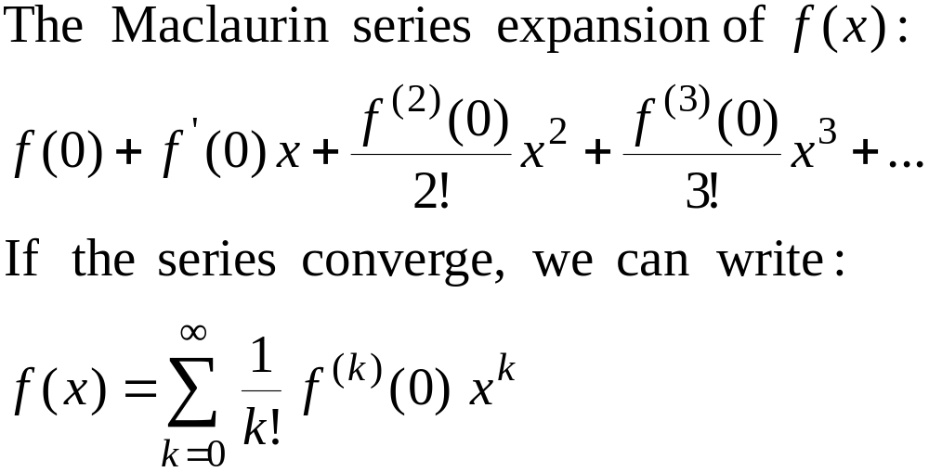
Maclaurin Series
Maclaurin series is a special case of Taylor series with the center of expansion a = 0.

Slide 25
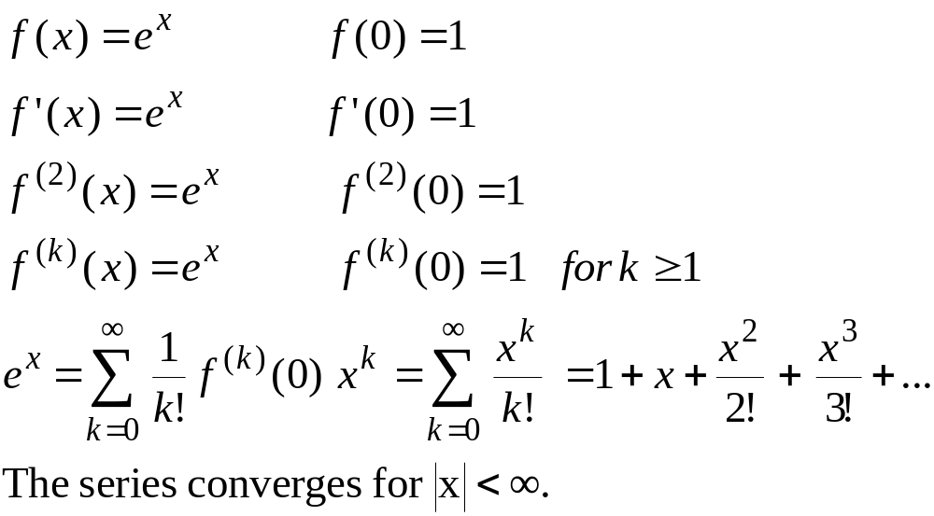
Maclaurin Series – Example 1

Slide 26
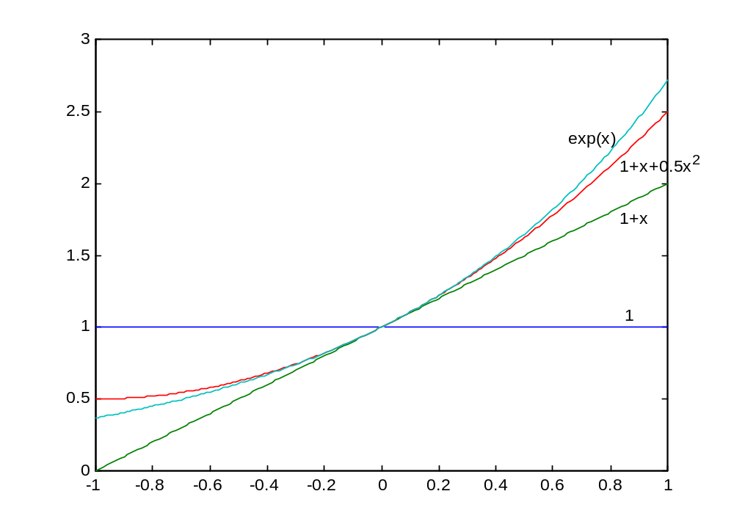
Taylor Series
Example 1

Slide 27
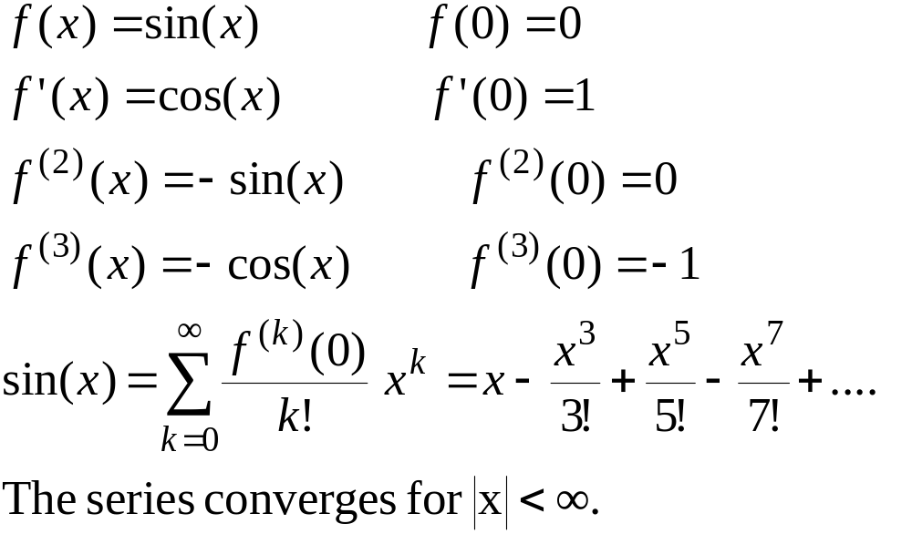
Maclaurin Series – Example 2

Slide 28
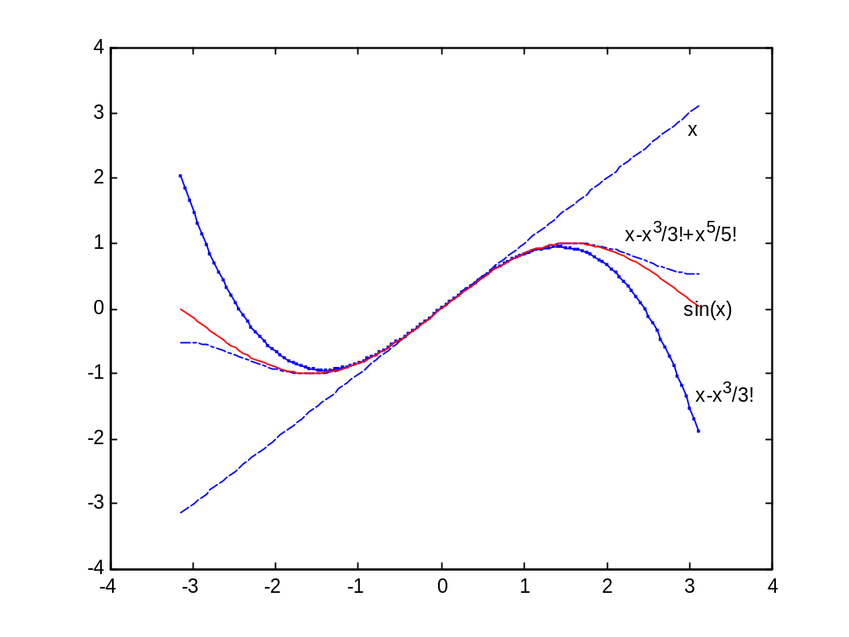

Slide 29
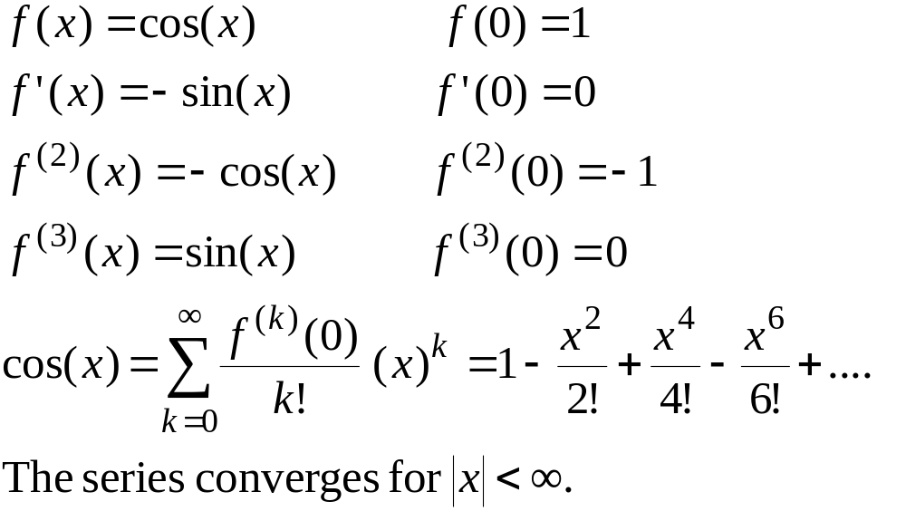
Maclaurin Series – Example 3

Slide 30
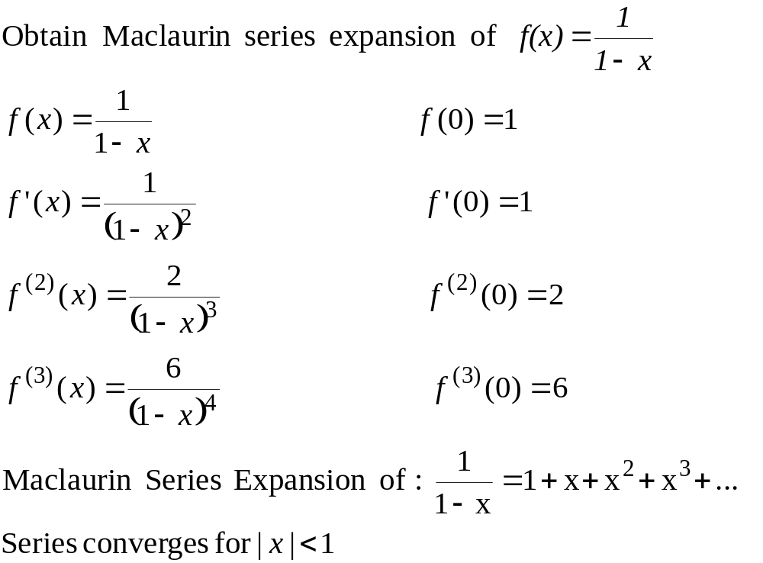
Maclaurin Series – Example 4

Slide 31
Example 4 - Remarks
Can we apply the series for x≥1??
How many terms are needed to get a good approximation???
These questions will be answered using Taylor’s Theorem.

Slide 32
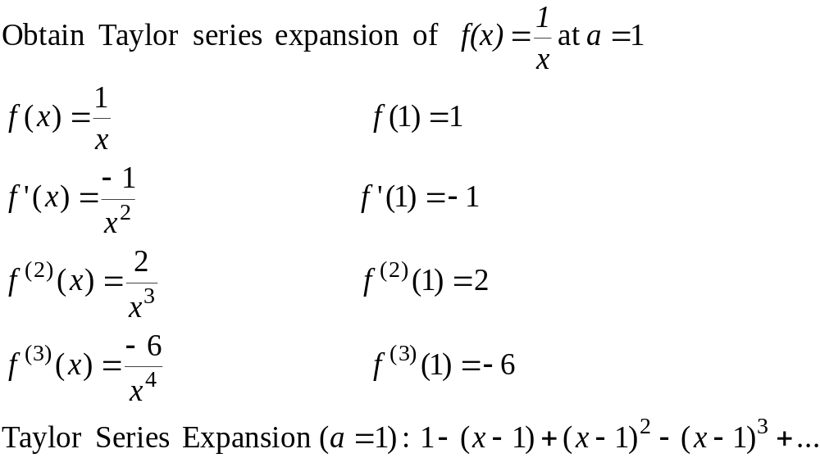
Taylor Series – Example 5

Slide 33
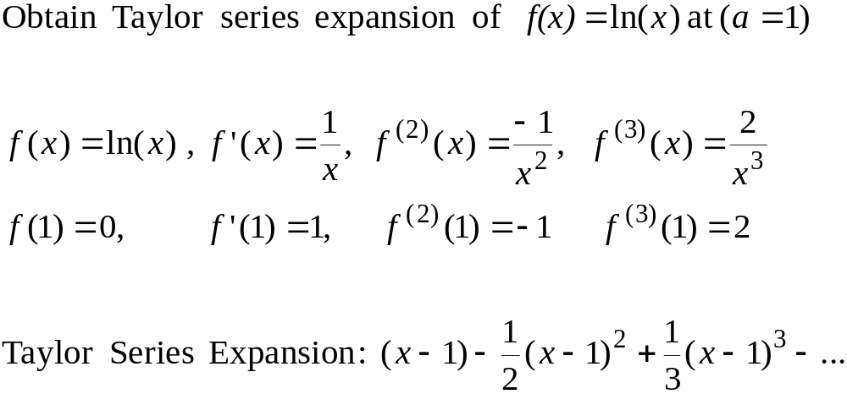
Taylor Series – Example 6

Slide 34
Convergence of Taylor Series
The Taylor series converges fast (few terms are needed) when x is near the point of expansion. If |x-a| is large then more terms are needed to get a good approximation.

Slide 35
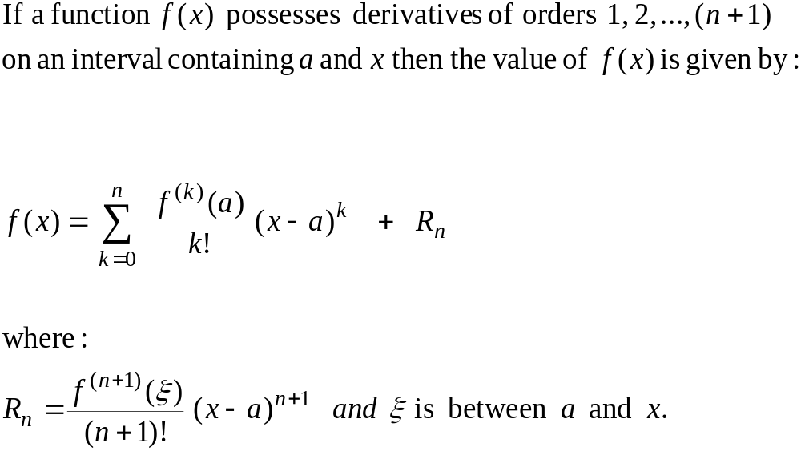
Taylor’s Theorem
(n+1) terms Truncated Taylor Series
Remainder

Slide 36
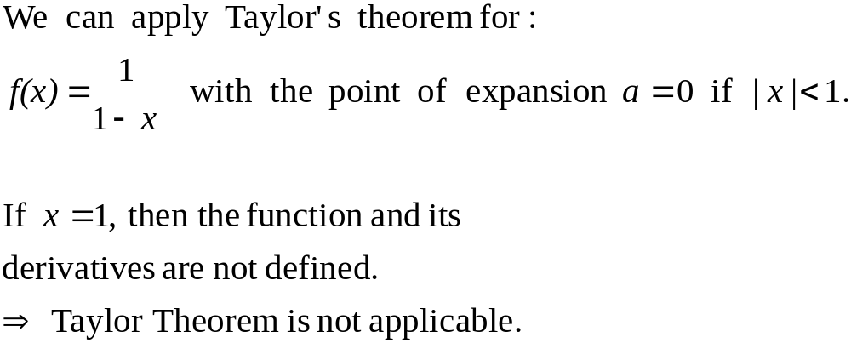
Taylor’s Theorem

Slide 37
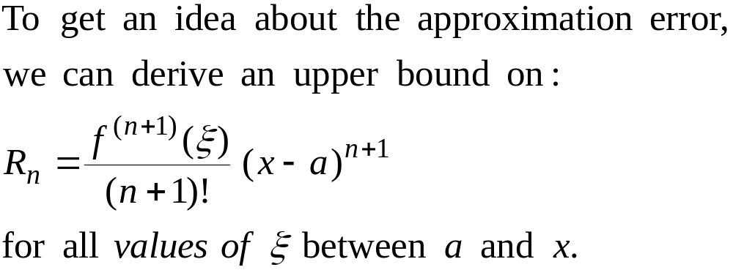
Error Term

Slide 38
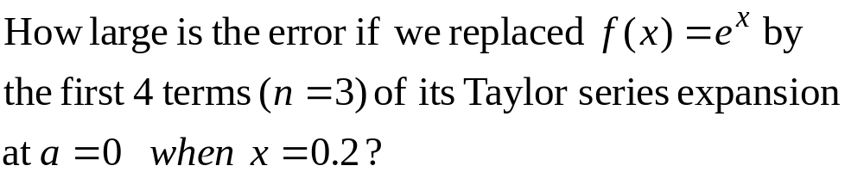
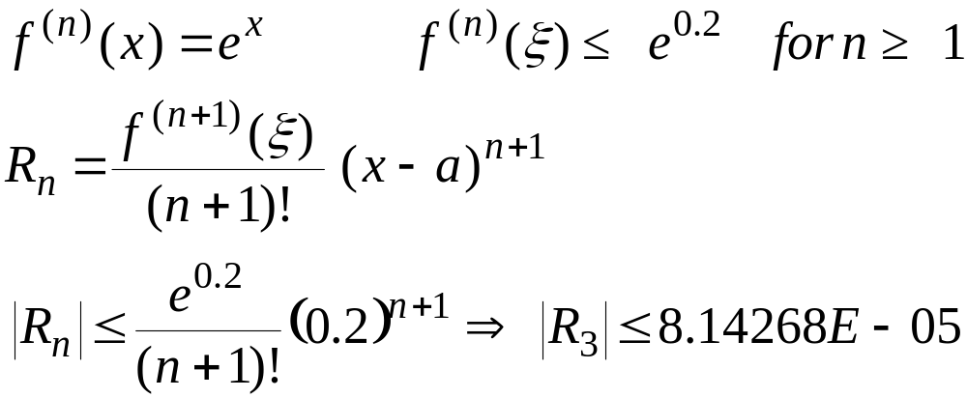
Error Term - Example

Slide 39
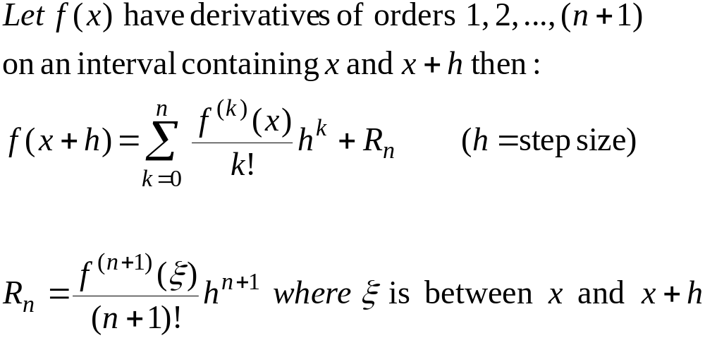
Alternative form of Taylor’s Theorem

Slide 40
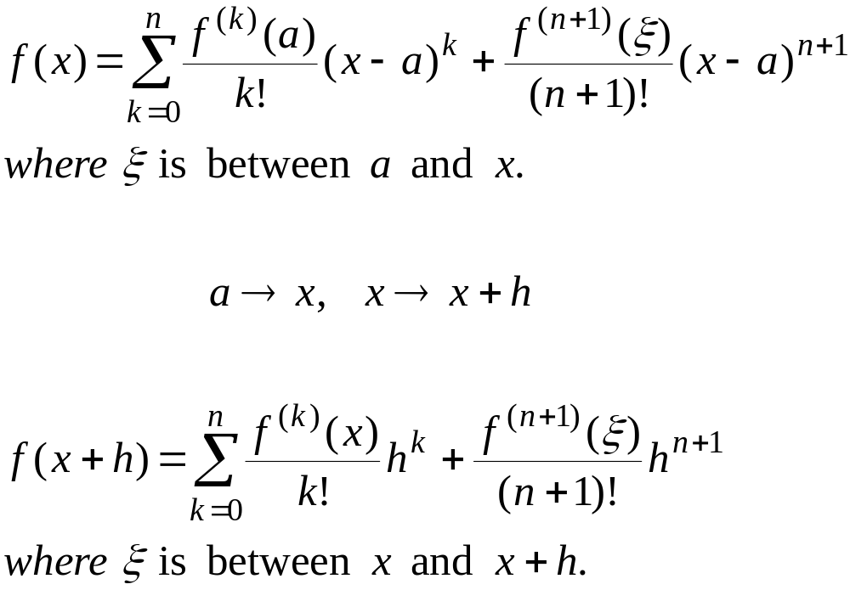
Taylor’s Theorem – Alternative forms

Slide 41
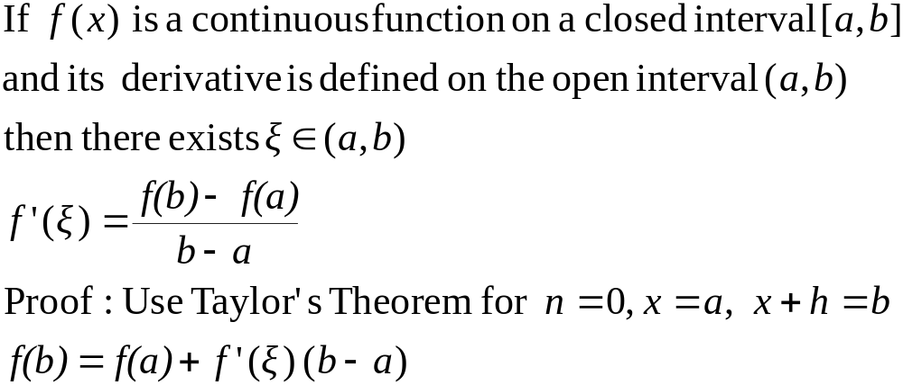
Mean Value Theorem

Slide 42
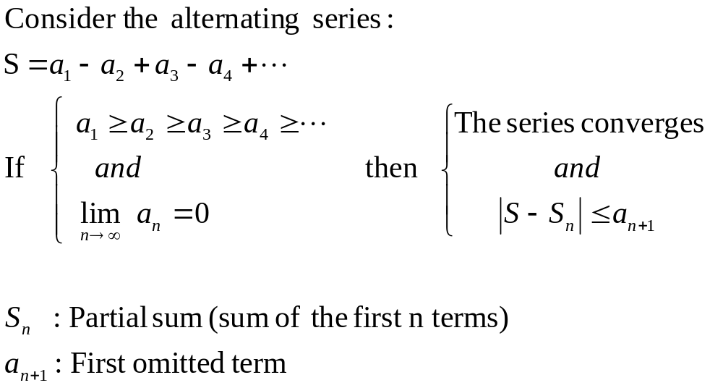
Alternating Series Theorem

Slide 43
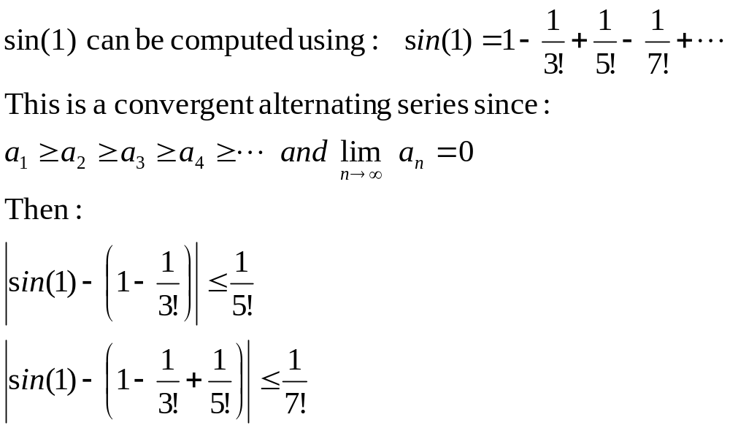
Alternating Series – Example

Slide 44
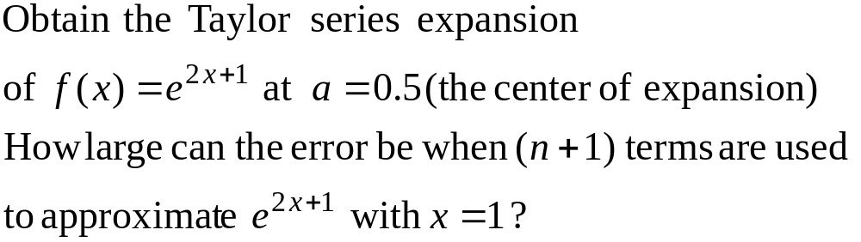
Example 7

Slide 45
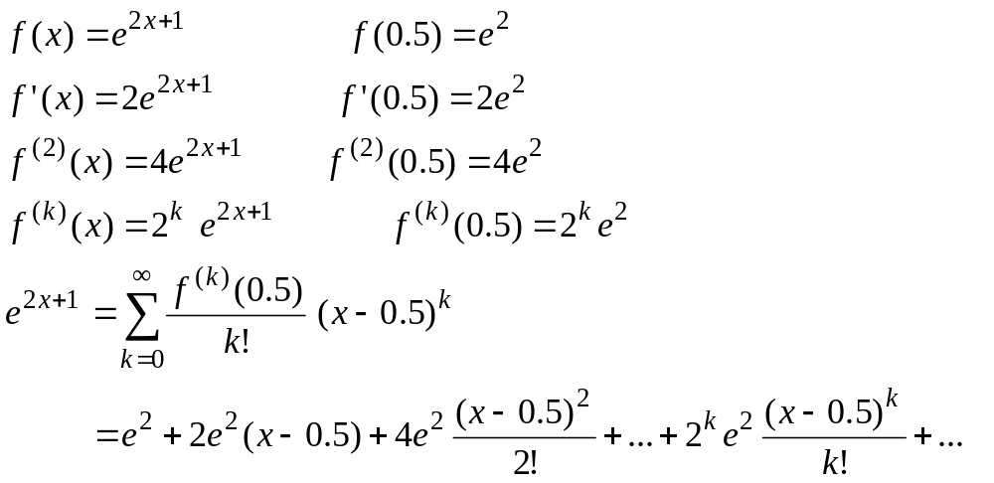
Example 7 – Taylor Series

Slide 46
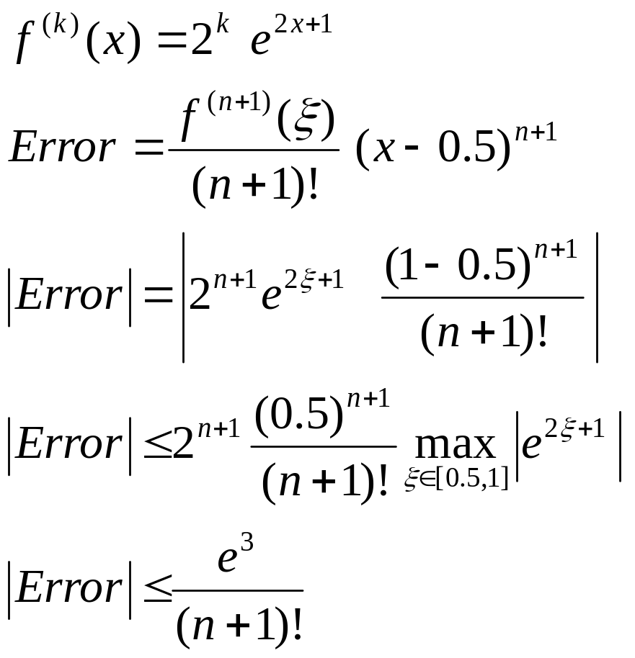
Example 7 – Error Term

